Slide 1
Wimborne Model Town (WMT)
River System Water Sustainability Project
Canford School
Project Kick-off Meeting
4th May 2020

Slide 2
Agenda
Meet the WMT team
Health and Safety
Familiarisation with site and facilities
The Project
Introduction to on-line Forum
Working on engineering projects as part of a team.
The development process and expected deliverables.
Q&A

Slide 3
INTRODUCTIONS
WMT River System Team:
  Penri Jones – Team Leader, Hardware, Planning, Groundwork.
  Terry Coles – Systems, Hardware, Software.
  Hamish McIntyre-Bhatty – Software, Groundwork.

Slide 4
Water Sustainability Project Goals
Save water (money):
  Stop leaks.
  Use less mains water.
  Active water management.
Save the environment:
  Scavenge and store rainwater.
  Cleaner water (less algae, etc).
  No pollution (no chemicals, metals, hydrocarbons, etc).
Education:
  For Visitors (the people who pay to get in).
  For Students (the people from local schools).

Slide 5
ON-LINE FORUM
The Project Teams at WMT maintain an online Forum at:
wmtprojectsforum.altervista.org
Previous work done by Canford School students can be found in the WMT River System/Canford School Projects topic.
This Forum is not just for the River System Project, but has been used extensively for discussion about the work to date.
The Forum may be viewed by anyone, but to post, a login is required. This can be created from the Home Page by clicking on the 'Register' link at the top right of the page.

Slide 6
River System - Simplified
Normal water flow:
Water spills out of the Bog Garden
Flows down the River channel
Ends up in the Sump
Circulation pump pumps the water back to the Bog Garden
Bog Garden
Water depth measurement probe
River
Valve
Valve
Water depth measurement probe
Circulation Pump
Butts Pump
River
Water Butts
Sump
A computer system automatically controls the flow and storage of water by measuring water levels at various points then turning on and off pumps or opening and closing valves.
For example:
If the depth probe detects there is too much water in the Sump, becasue it's rained perhaps, the Butts Pump will be turned on routeing the excess water into the Water Butts.
Should the level in the Sump drop, due to evaporation from the river, the Sump depth probe will detect this and water will be allowed to flow back into the sump from the water butts by opening the Valve

Slide 7
River System – as it is
The actual water collection and storage system is a little more complicated and more functionality may be added in the future.
Water piepe
Bog Garden
Water depth measurement probe
River
Valve
Water depth measurement probe
Circulation Pump
Butts Pump
River
Water Butts
Valve
Sump
Mains water supply
Water depth measurement probe
Water depth measurement probe
Water depth measurement probe
Water depth measurement probe
Valve
Valve
Valve
Valve

Slide 8

River System – what's needed
A Web based graphical user interface (GUI) for the river system, water storage and control items with animated icons to show the status of each part of the system.
Water piepe
Bog Garden
River
Valve
Circulation Pump
Butts Pump
River
Water Butts
Valve
Sump
Mains water supply
750l
500l
Valve
Valve
Valve
Valve

Slide 9
Deliverables
An attractive, simplified and stylised map of the river and water storage system.
Animated icons, including a numerical valve, for the quantity being measured or controlled.
Icon | Measured quantity range | Measured quantity units | Comment
Water flow direction and rate | Forward / reverse No flow to full flow | Litres per second Units need to be scalable | Maximum flow rate depends on location of probe to S/W need to accommodate this
Water level | Empty to full | Litres in 2.5% steps Units need to be scalable | Maximum water level depends on location of probe to S/W need to accommodate this
Water valve status | Fully closed to fully open | 1% steps
Pump speed | Off to fully on | 10% steps
Max/min float switch | 3 states Max / Intermediate / Min
Amount of water in river system | 0 to 20,000 litres | Litres
Amount of water in storage | 0 to 10,000 litres | Litres

Slide 10
Requirement
The display must be informative and intuitive providing the visitor with an appreciation of the workings and status of the river system without overwhelming them with technical detail.
A Requirement Specification (WMT_River_System_GUI_Reqs_Iss_1.0) specifies in detail the requirement.
More that one icon of each type will be required.
The icons must be appropraitely sized for the map and scalable for the size of screen displaying them – assume 1028 by 720 pixels as default

Slide 11


GUI High Level Architecture
NAS Box
Switch
Database
Part 1
River System Data Collection
River System Pis
n
n

Slide 12


GUI High Level Architecture
Part 2
Presentation of Data
NAS Box
Switch
Database
Webserver Pi
Page
Generation
River System Pis
Nginx
n
Static Pages
Wi Fi
Antenna

Slide 13
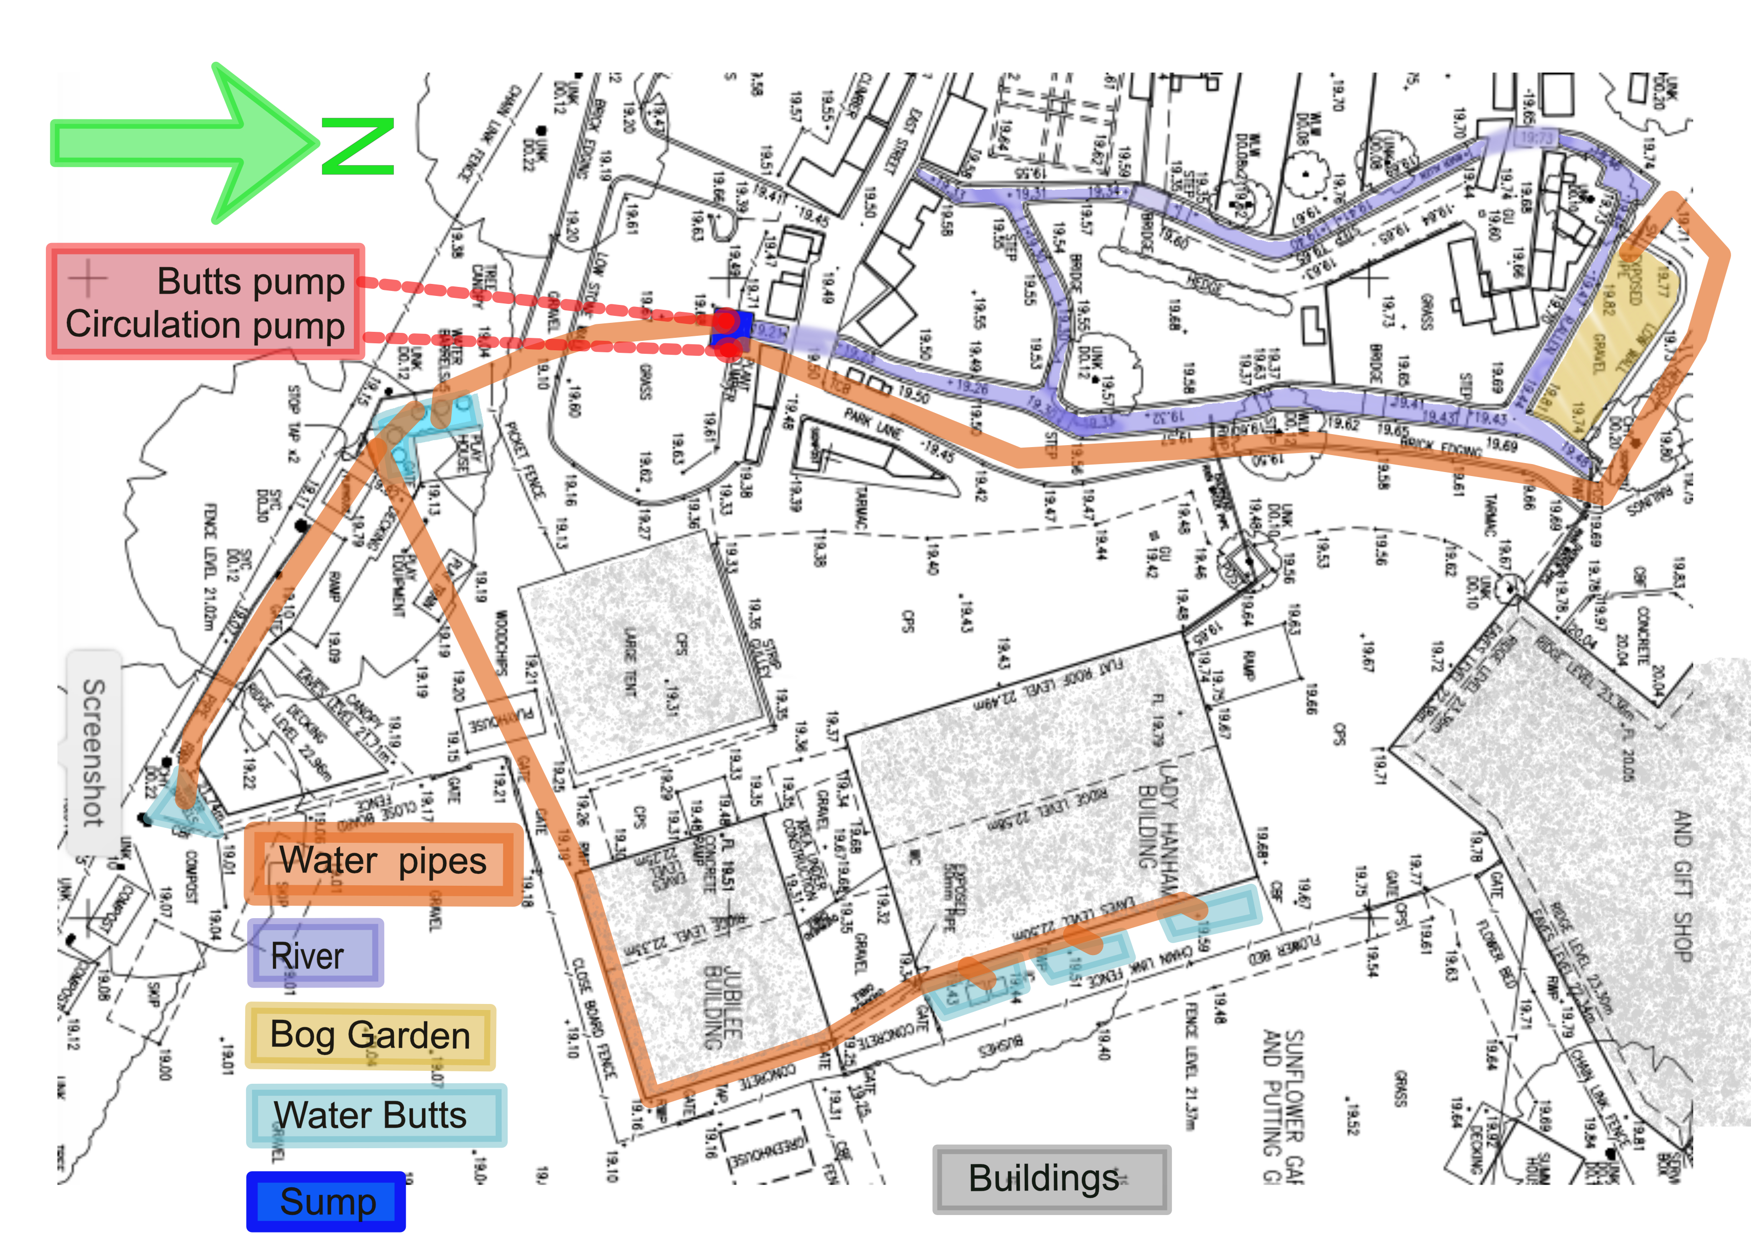
Detailed ground plan

Slide 14
Photos of WMT here
I'll insert photographs of WMT with references to the ground plan here when I've taken them.

Slide 15
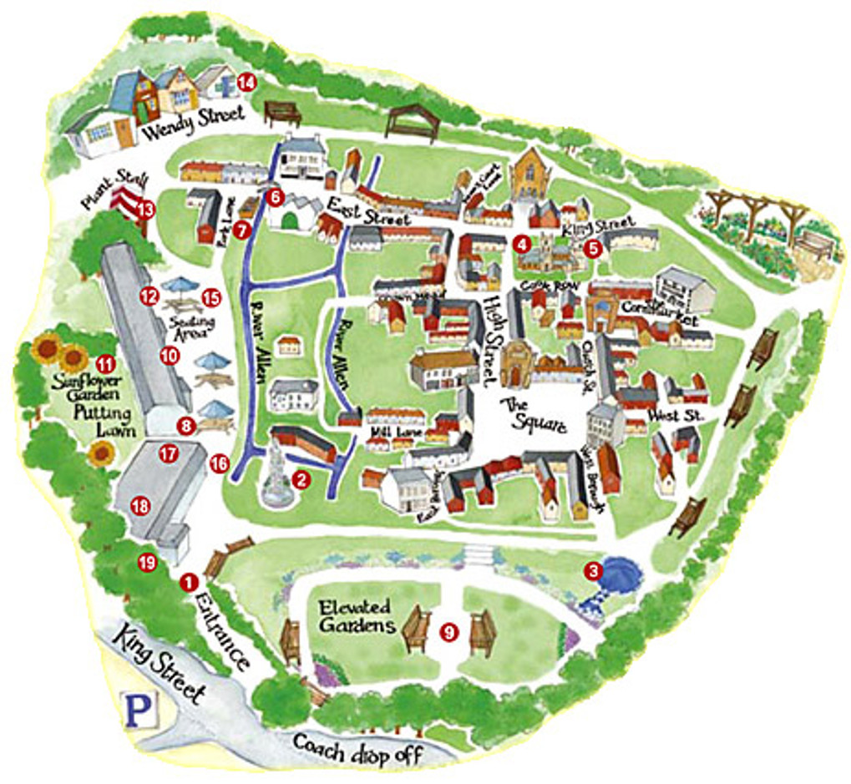
Wimborne Model Town
Artistic rendering of Model Town
N
Web site: www.wimborne-modeltown.com

Slide 16
Questions and Answers

Slide 17
Additional information

Slide 18
Health and Safety (1)
All Volunteers must be aware of the following key points from the WMT Health and Safety Policy:
  Know the location of the exits from the site and the fire muster point. These areas will be pointed out during the site tour.
  If you discover a fire or a fire alarm is raised then you must move to the muster point. Do not attempt to fight the fire.
  Know the nature of specific hazards in the main work areas on the site.
  If needed, Personal Protective Equipment will be provided and this must be worn as directed.

Slide 19
Health and Safety (2)
Key points continued:
  In the event of an accident, first aid kits and trained first aiders are available. Do not attempt to carry out first aid yourself.
  Do not attempt to lift any heavy or awkward loads without assistance from someone trained in manual handling.
  You may not use any hazardous chemicals unless supervised by a member of staff.
  You may not work on any mains electrical equipment or circuits carrying more than 50 V.
  When working outdoors, precautions must be taken if you are exposed to bright sunshine for prolonged periods.

Slide 20
INTRODUCTION TO ON-LINE FORUM
WORKING ON ENGINEERING PROJECTS AS PART OF A TEAM
The Forum is a very useful tool which aids the development of the work in many ways:
  Primarily, it is a very efficient means of communication. Earlier projects relied heavily on email and face to face discussions, but this has a number of disadvantages.
  The use of a forum helps with teamwork because:
    Team members who become involved later can review the earlier work.
    Topics can be discussed and agreed in some detail before work begins.
    Face to face meetings are much more efficient, because much of the discussion has already happened.
    A written record exists of all points of view and decisions taken.

Slide 21
THE DEVELOPMENT PROCESS
WMT projects use a development process which has been proven in Industry over many years:
  Requirements are written and agreed by the 'Stakeholders'.
  A Design is proposed and accepted .
  The system is implemented and tested using an 'agile' process. This is known as Integration.
  The completed system is presented to the WMT management (who have been pretty involved from the start so problems at this stage are rare).

Slide 22
EXPECTED DELIVERABLES
Deliverables:
  A Design document, that details the solution to the specific Requirements.
  A working version of the solution which might be:
    A software program.
    A piece of hardware.
    A change to the river environment.
  Where applicable, detailed maintenance and repair information.
  A demonstration of the solution in situ.

